Slide 1
FORCE AND MOTION LAB ACTIVITY

Slide 2
TASK:
Your objective today is to build a bristlebot that will travel in a straightest possible line for 2-3 feet.

Slide 3
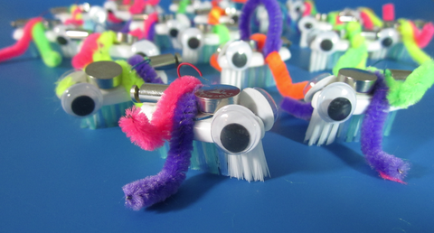
These are
bristlebots.

Slide 4
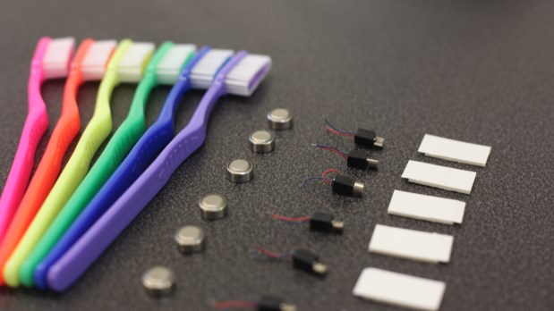
You will work in your table groups to accomplish this task.
Each group will receive a baggie with the following supplies:
A toothbrush head
Pipe cleaners
A pair of eyes
Bristlebot motor
2 adhesive pads
Battery
Your teacher will provide you with a strip of painter’s tape when you’re ready.

Slide 5
Each of you has been given a baggie with a number on it. Please write the number on your baggie on your lab sheet.
The first thing you will do is assemble your bristlebot.
Test your battery. Take your motor’s wires and touch one wire on the top of the battery and the other wire to the bottom of the wire. The motor should vibrate vigorously.

Slide 6
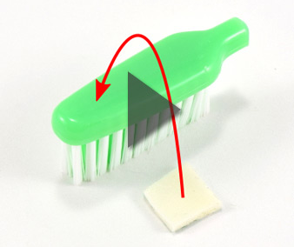
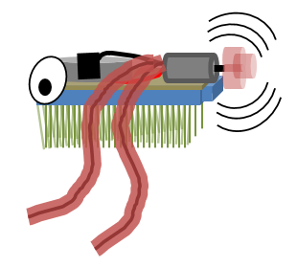
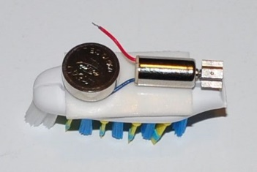
2
Attach the adhesive pads to the top of the toothbrush.
Place the motor on the adhesive pad so that the back of the motor can turn. If the motor can’t turn your bristlebot will not move.
Place the battery on the top so that its sitting on one of the wires.
3
4

Slide 7
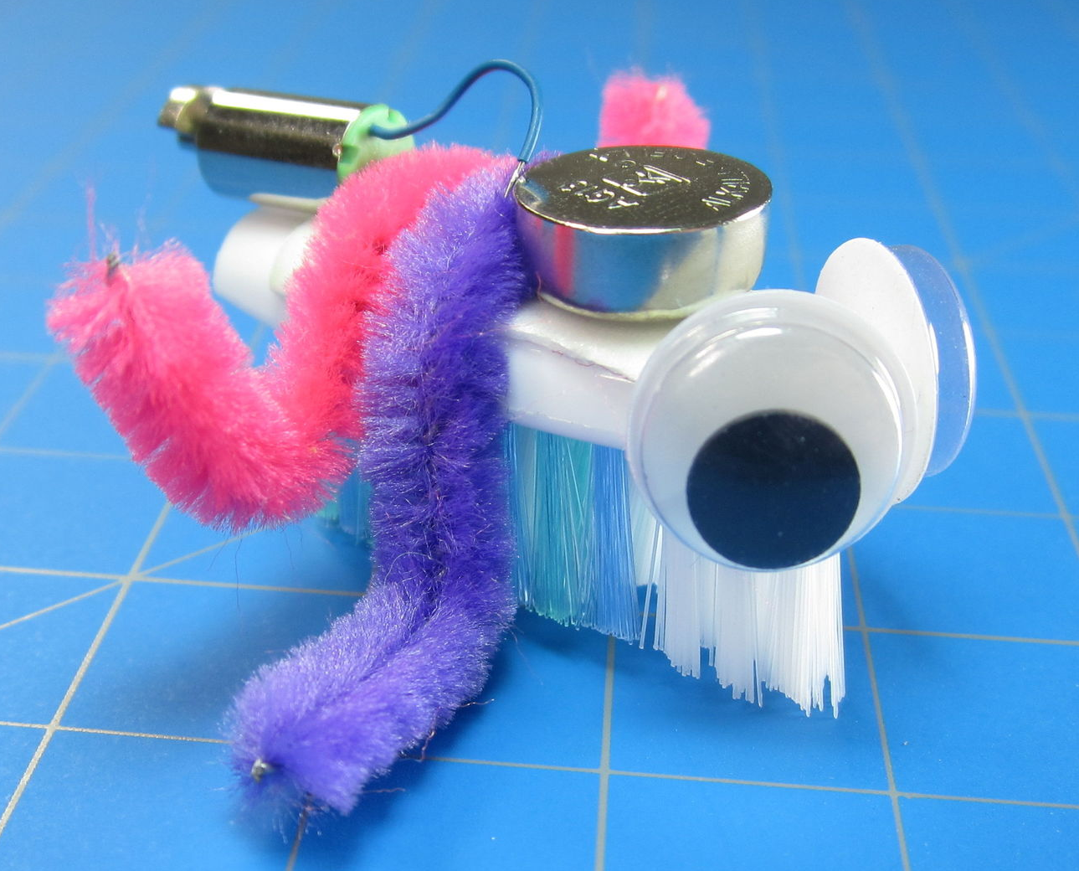
Get a strip of painter’s tape lay it over the second wire. This will be your on off switch. When you’re ready to test your bristlebot, lay the tape w/ the wire attached on the top of the battery. Your bristlebot should be ready to go.
Now here comes the fun part. Add your eyes and use the pipe cleaners to balance the forces so that your bristlebot will move in a straight line. You will make adjustments until you get it to work correctly.
Good Luck! May the Force Be With You!
5
6

Slide 8
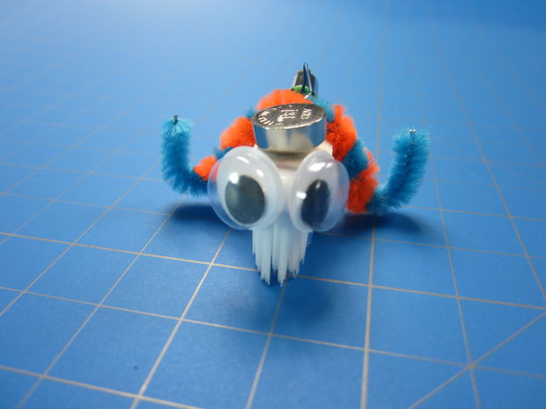
When the lab is completed call the Teacher and she will disassemble it for you so that there are no mishaps with supplies. Make sure you are completing your lab sheet and you go through the activity.
Good Luck!
May the
Force Be With YOU!

Slide 9
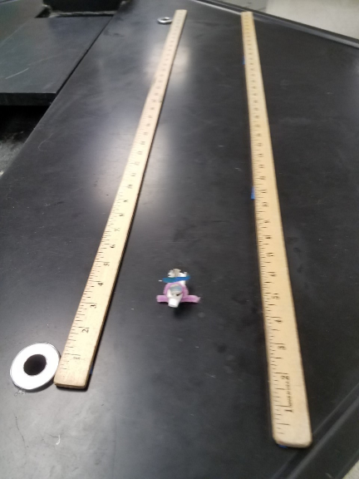
Name: _____________________________ Date ___________ Period: ________
Bristlebot Challenge
Objective: Create a Bristlebot that travels in the straightest line possible.
You will explore how balance and unbalanced forces affect the motion of an object.
Trial 1 | Trial 2 | Trial 3
Sketch the design of your bristlebot. | Sketch the design of your bristlebot. | Sketch the design of your bristlebot.
Did your bristlebot go straight? What adjustments did you make? | Did your bristlebot go straight? What adjustments did you make? | Did your bristlebot go straight? What adjustments did you make?
How far did it travel in a straight line? _____ | How far did it travel in a straight line? _____ | How far did it travel in a straight line? _____

