Slide 1
Speed, Velocity and Acceleration

Slide 2
SPEED
You are writing this on the left.
Speed describes how fast an object is moving
Formula for speed: s = d/t
Units for distance = meters(m)
Units for time = second (s)
Units for speed = meters/second

Slide 3
SPEED
Example of Speed:
Car moving 30 m/sec
d
distance
÷
X
You are writing this on the right.
s
speed
t
time

Slide 4
velocity
Velocity describes how fast an object is moving and the direction it is moving in
Formula for velocity: v = d/t
Units for distance = meters(m)
Units for time = second (s)
Units for velocity = meters/second
w/ direction
You are writing this on the left.

Slide 5
velocity
Example of Speed:
Car moving 30m/s, South
d
distance
÷
X
v
velocity
t
time
You are writing this on the right.

Slide 6
Acceleration
Acceleration describes a change in speed and/or direction
Three types of acceleration:
1. speeding up
2. slowing down
3. changing direction
Formula for speed: a = v_{f} – v_{i}
t
Units for velocity = meters/second (m/s)
Units for time = second (s)
Units for acceleration = meters/second/second
(m/s²)
You are writing this on the left.

Slide 7
acceleration
Example of Speed:
Car sped up to 40mph
The runner slowed down
The car turned the corner
d
distance
÷
X
v
velocity
t
time
You are writing this on the right.

Slide 8
Now let’s us put what you’ve learned to the test.
You are going to identify the following examples as examples of speed, velocity or acceleration.

Slide 9
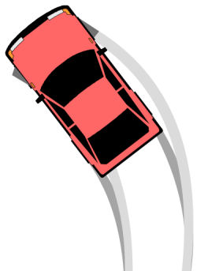
ACCELERATION

Slide 10
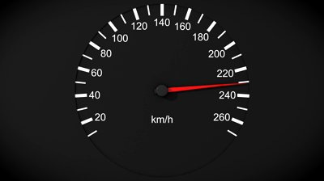
SPEED

Slide 11
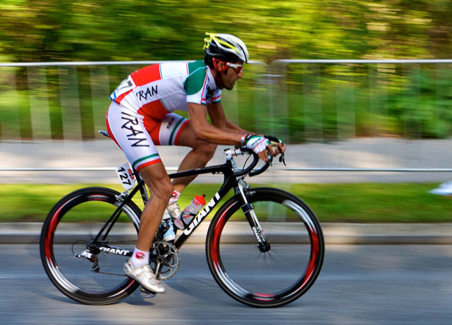
The cyclist is moving
65 miles/hr South.
VELOCITY

Slide 12
The athlete is running towards the finish line.
VELOCITY

Slide 13
The train is moving at 200 miles/hr.
SPEED

Slide 14
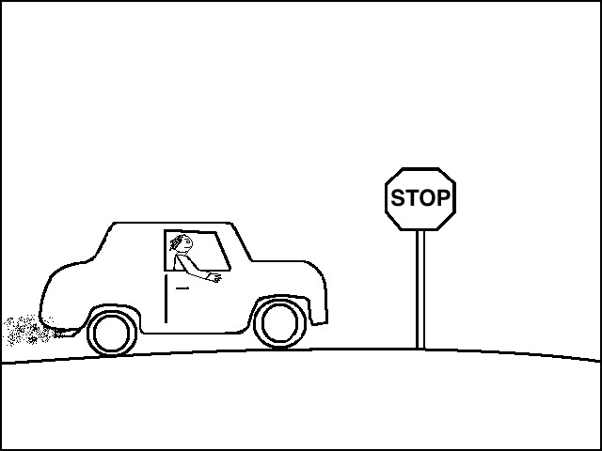
The car slowed down as it approached the stop sign.
ACCELERATION

Slide 15
The rocket is moving towards the moon at
150 m/s.
VELOCITY

Slide 16
The plane traveled 200 miles in 1 hour.
SPEED

Slide 17
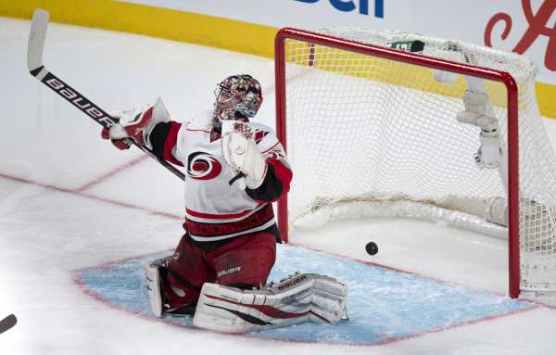
The hockey puck slid into the goal past the goalie
VELOCITY

Slide 18
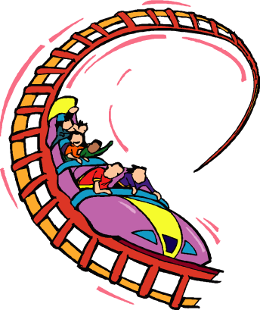
The roller coaster went from 45 m/s to 80 m/s in 3seconds.
ACCELERATION

Slide 19
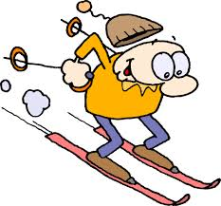
Jed is moving at 60 miles/hr.
SPEED

Slide 20
While on a weekend trip to New York City, you spot Beyonce and JayZ moving South down 5th Ave. and just HAVE to meet them. You run after them for 80 meters. It took you 15s to catch up with them? At what velocity are you moving?
What are you looking for? What information has been given? | Equation you will use?
Solve the problem | Answer with Units
velocity
Velocity = distance/ time
Distance = 80 meters
Time = 15 seconds
Velocity = 80 m/15 s
= 5.33m/s
Velocity = 5.33m/s, South

Slide 21
Hudson is playing Lyles, the score is tied and there is only 10 seconds left in the 4th quarter. KJ has the ball and he has 45 yards to cover before he makes a touchdown. How fast must KJ run to reach the goal line in time?
What are you looking for? What information has been given? | Equation you will use?
Solve the problem | Answer with Units
speed
speed = distance/time
Time = 10 sec
Distance = 45 yards
Speed= 45 yards/10 sec
= 4.5 yards/sec
Speed = 4.5 yards/sec

Slide 22
Desrinee and Malia decide to take the DART train to the movie theatre near North park mall to see Divergent. The train starts from rest and reaches a speed of 54 km/h in .30h. Find its acceleration.
What are you looking for? What information has been given? | Equation you will use?
Solve the problem | Answer with Units
Acceleration
Acceleration = vf – vi
time
Vf = 54km/h vi = 0km/h
time = .50 hours
Acceleration = 54km/h – 0km/hr
.50hrs
= 108km/hr²
Acceleration = 108km/hr²

Slide 23
Ms. Heffner and Maricio are trying to move a computer cart to Ms. Wiltz’s classroom. How much force must be applied to the 100kg cabinet if they want it to move through the hallway at 3m/s²?
What are you looking for? What information has been given? | Equation you will use?
Solve the problem | Answer with Units
Force
Force = m x a
Mass = 100kg
Acceleration = 3m/s²
Force = 100kg x 3m/s²
= 300kg/m/s²
Force = 300kg/m/s²
= 300N

