Slide 1
Fun With Speed, Velocity and Acceleration
(Also called KINEMATICS)

Slide 2
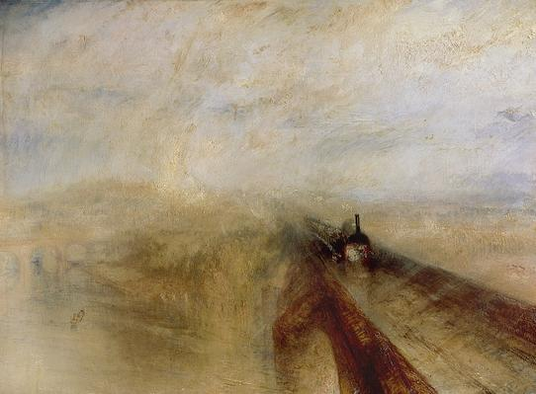
Rain Steam and Speed, The Great Western Railway, painted before 1844 by: Joseph Turner
KINEMATICS in Art!

Slide 3
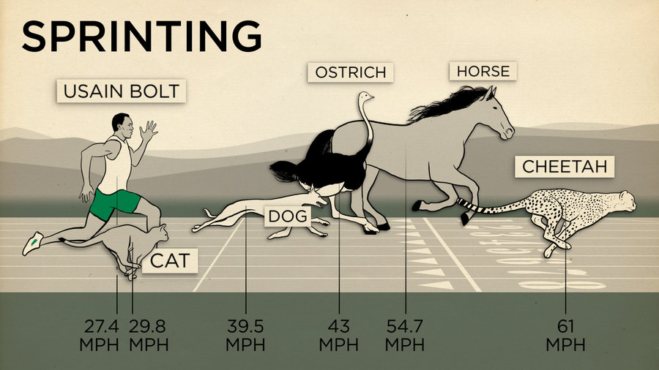
www.pbs.org

Slide 4
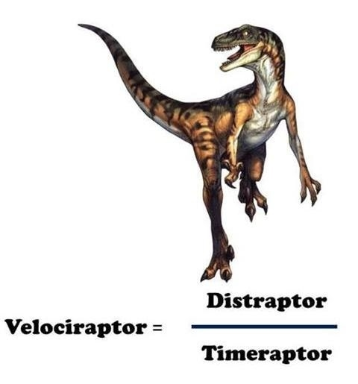

Slide 5
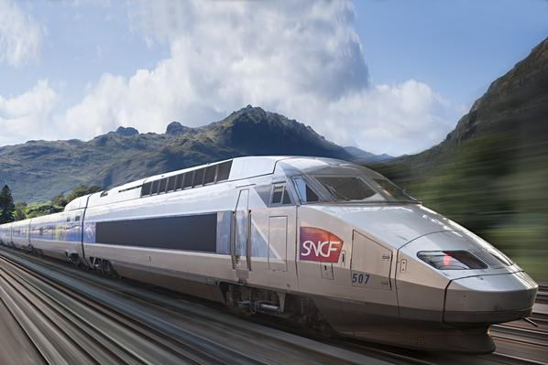
High speed train TGV in countryside
( Free license photo – PBS.edu)

Slide 6
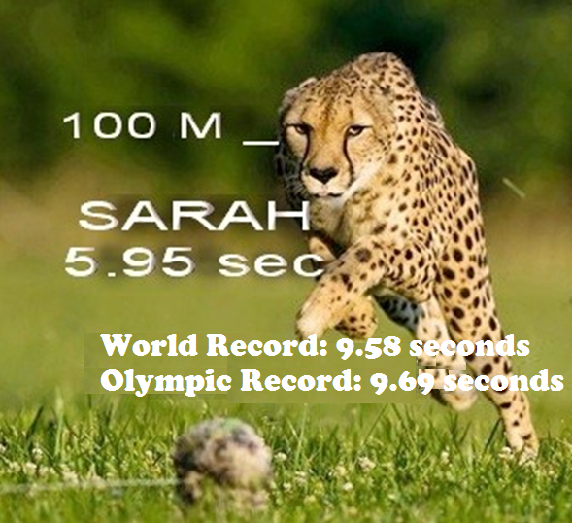
How fast can a cheetah run a 100m dash?
The fastest ever recorded speed of a cheetah is 5.95 secs set in 2012.
The cheetah, named Sarah, clocked a whopping maximum speed of 61 mph, which is almost 100 kmph!!
What was her acceleration?

Slide 7
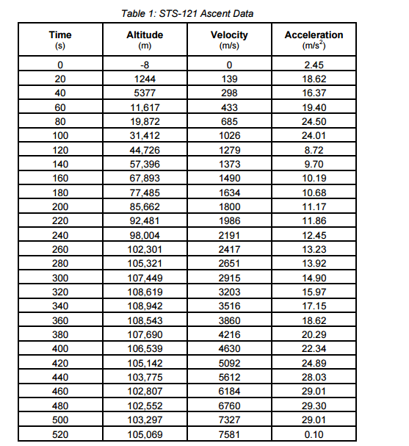
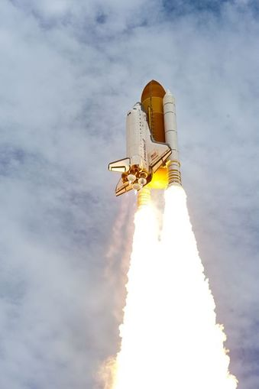
NASA, Space shuttle Atlantis July 2011 NASA.org

Slide 8

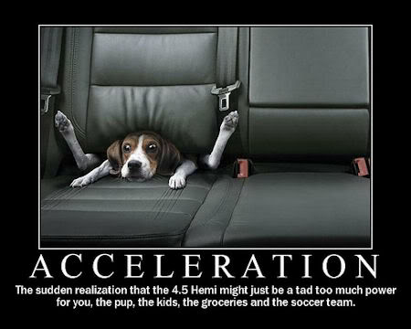

Slide 9
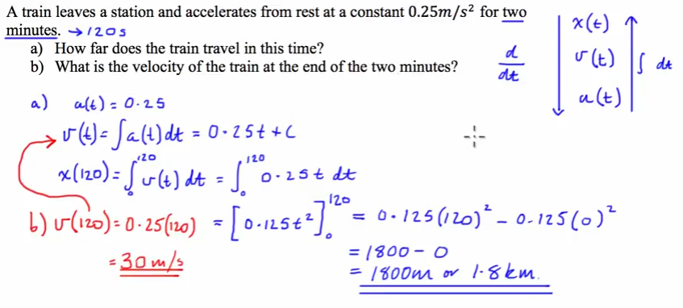
KINEMATICS in Calculus!

Slide 10
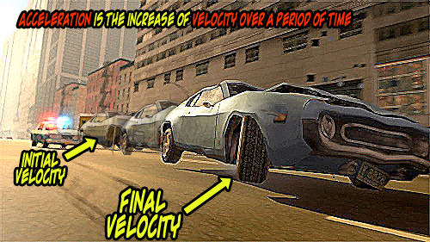

Slide 11
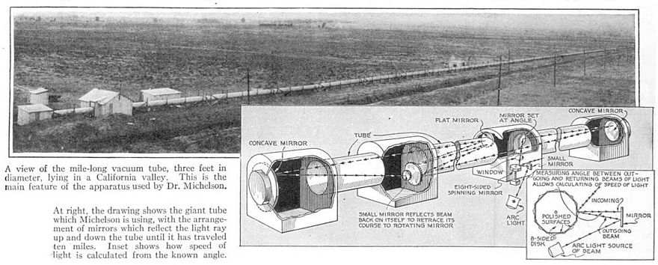
KINEMATICS in History!

Slide 12


Slide 13
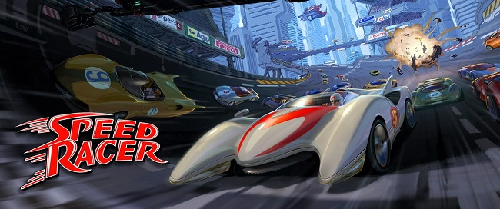

KINEMATICS IN MOVIES!

Slide 14
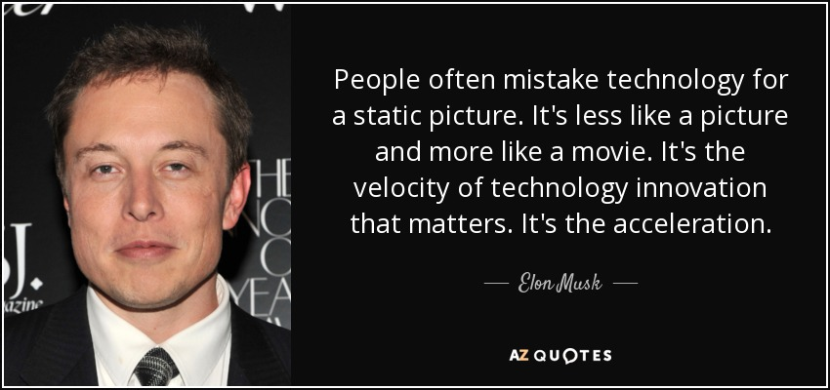
He should know! He’s the founder of SpaceX (think private aerospace to colonize Mars) AND he’s a designer for Tesla!

