Slide 1
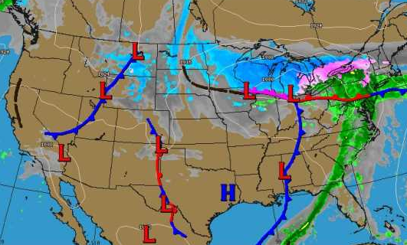
WEATHER
FRONTS
BY: Annette Miles

Slide 2
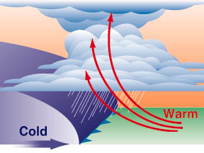
A cold front is a boundary between a ____ moving cold, ___ air mass, and a ______ moving warm, _____ air mass. This causes the warm, moist air to rise _____ and condense quickly into clouds.
fast
dry
slower
moist
rapidly

Slide 3
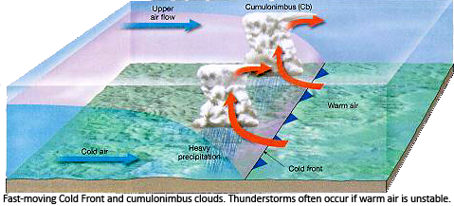
If the temperature difference between the cold and warm air is large, ____________ and even ________ may develop.
thunderstorms
tornadoes

Slide 4

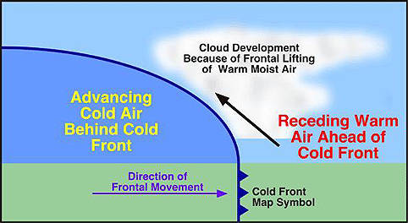
This is the symbol meteorologists use to indicate a cold front on a map.

Slide 5
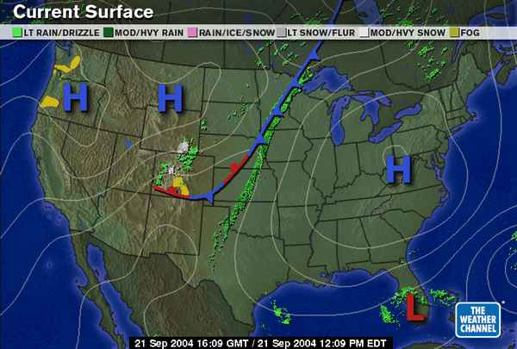
Can you find a cold front on this map?
(Which direction is it moving?)

Slide 6
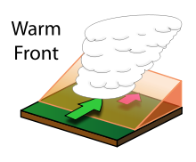
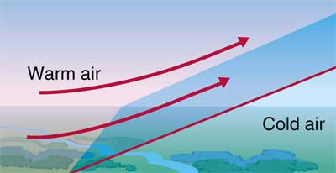
A warm front is a mass of _____ air that rises up over and replaces a mass of ____ air.
warm
cold

Slide 7
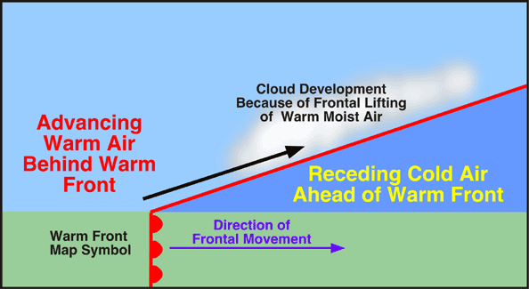
dense
As the warm, less _____ air moves up and over the cooler air, moisture in the warm air begins to condense and form ______. ___________ is likely.
clouds
Precipitation

Slide 8

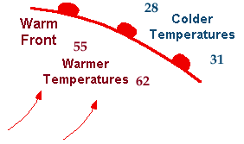
This is the symbol meteorologists use to indicate a warm front on a map.

Slide 9
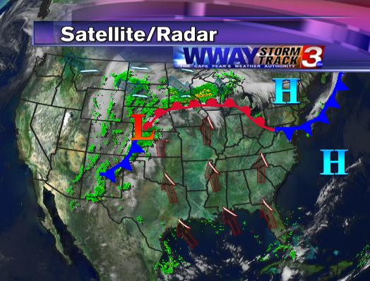
Can you find a warm front
on this map?
(Which directions is it moving?)

Slide 10
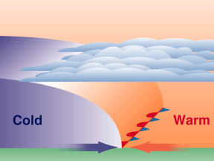
A stationary front is a boundary between a warm, moist air mass and a cold, dry air mass, neither of which are ______. The air masses remain in the same _____ for an extended period of time.
moving
place

Slide 11
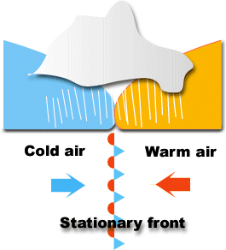

This is the symbol meteorologists use to indicate a stationary front on a map.
COLD AIR
WARM AIR

Slide 12
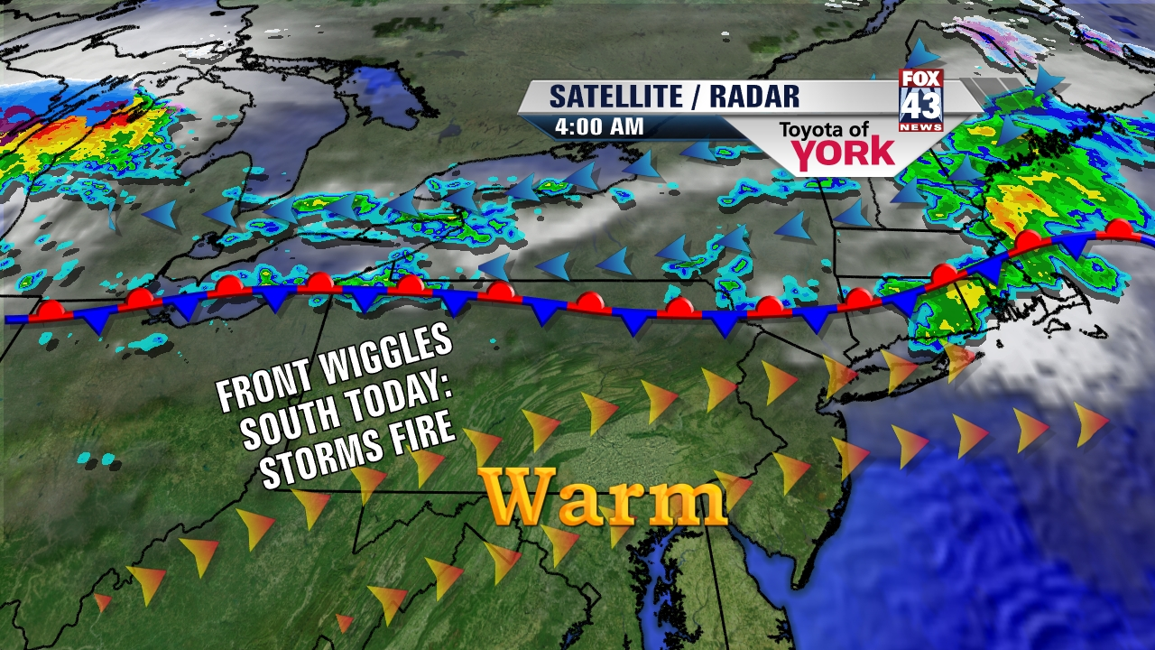
The weather associated with a stationary front is often ______ days of cloudy skies with ________ showers.
several
scattered

Slide 13
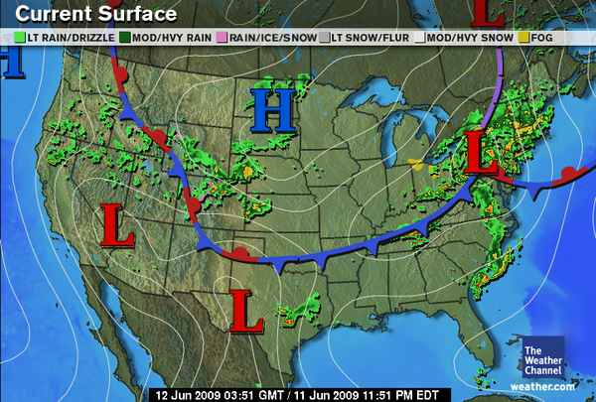
Can you find the stationary front on this map?

Slide 14
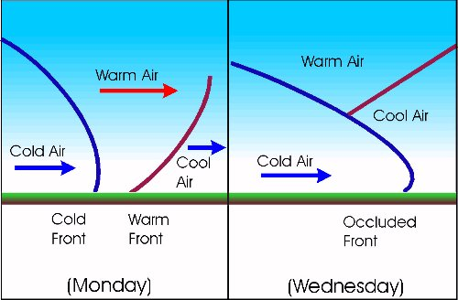
Sometimes a cold front is following ______ a warm front traveling in approximately the _____ direction. The cold front moves faster and “_______ up with” and “overtakes” the warm front.
behind
same
catches

Slide 15
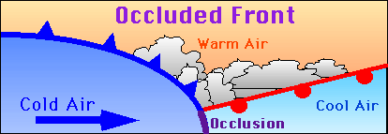
After the cold front overtakes the warm front, it meets with the ______ air that was ahead of the warm front. The warm moist air is __________ between the two cooler air masses. This is called an ________ front.
cooler
pushed up
occluded

Slide 16
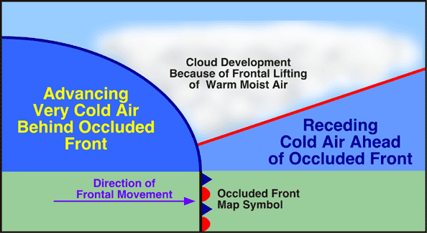
With the lifting of the warm, moist air, clouds form and ___________ is possible.
precipitation

Slide 17

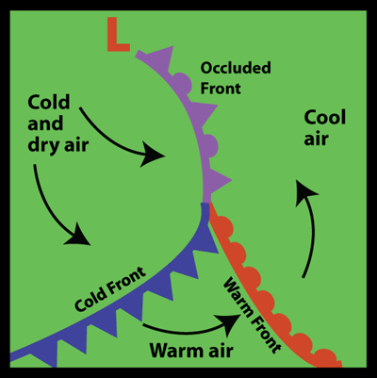
This is the symbol meteorologists use to indicate an occluded front on a map.
The occluded front ends at a low pressure area and the other end connects to cold and warm fronts.

Slide 18
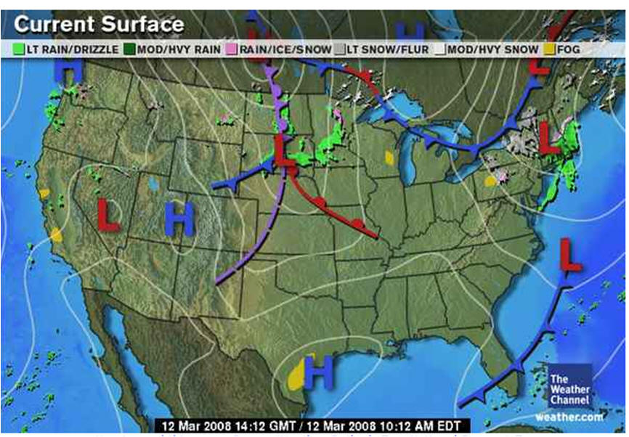
Can you find the occluded front on this map?

Slide 19
Identify the following front.
Warm Front

Slide 20
Identify the following front.
Cold Front

Slide 21
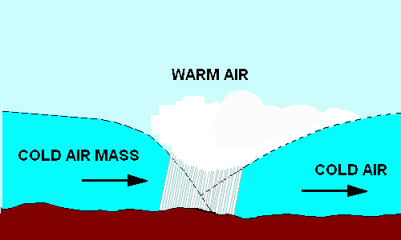
Identify the following front.
Occluded Front

Slide 22
Identify the following front.
Stationary Front

Slide 23
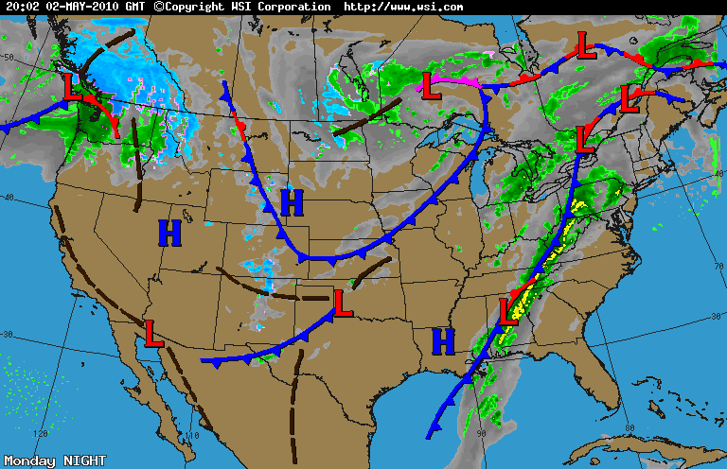
According to this map, what kind of weather will Atlanta, Georgia be experiencing soon? What kind of front will produce this type of weather?
A stationary front could cause rain showers soon.

Slide 24
According to this map, how will the weather be different in St. Louis, Missouri, tomorrow?
A cold front is approaching from the north so the temperature should be cooler tomorrow.

Slide 25
RESOURCES
http://www.kidsgeo.com/geography-for-kids/0129-stationary-fronts.php
http://commons.wikimedia.org/wiki/File:Stationary_front_symbol.svg
http://fox43.com/2013/04/10/small-severe-weather-chance-today/#axzz2Q5mGDAsx
http://www.edupic.net/weather_gr.htm
http://en.wikipedia.org/wiki/Warm_front
http://www.physicalgeography.net/fundamentals/7r.html
http://www.hpc.ncep.noaa.gov/html/fntcodes2.shtml
http://weather.about.com/od/imagegallery/ig/Weather-Map-Symbols/Warm-Fronts.htm
http://pages.bangor.ac.uk/~oss006/meteorology/frontsalevel.html
http://www.verticalfrontiers.com/knowledge/cloud-spotting-weather-fronts/occludedfront2/
http://kidlat.pagasa.dost.gov.ph/genmet/fronts/occludedfront_b.gif
http://blog.silive.com/weather/2009/06/the_weekend_weather_95.html
http://4.bp.blogspot.com/_57jRgDt4zro/TU7nUDEMeHI/AAAAAAAAB4k/TplPzIkbWto/s1600/Weather+Forcast+for+May+2+2010.gif

