Slide 1
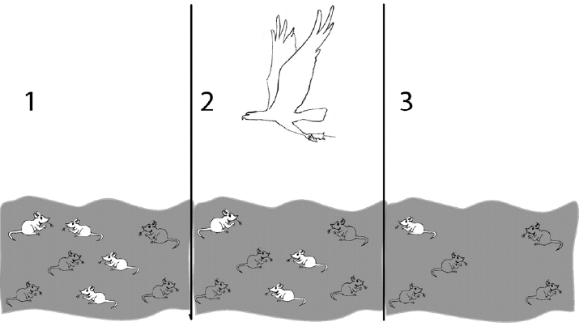
Natural Selection

Slide 2
What is Natural selection?
Also known as “survival of the fittest”
A process in which organisms have traits that enable them to survive :
Environmental pressures
Predators
Changes in climate
Competition for food or mates
These organisms are more likely to survive and reproduce than other members of the same species.
Process occurs over a long period of time

Slide 3
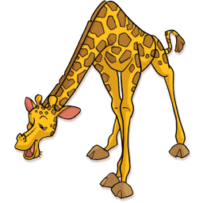
Let’s watch a video that explains
Natural Selection
http://safeshare.tv/w/UGcTzAycco

Slide 4
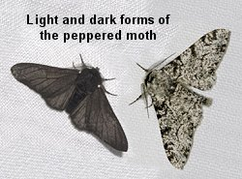
What is a trait?
A trait is a characteristic passed on from the parent to its offspring (child).
Some traits are better to have than others because they help an organism to survive their environment.
In Natural selection some traits are better suited for an organism to survive. Lets watch the story of the peppered moth.
http://safeshare.tv/w/vdRKQoTUmc

Slide 5


Relating Cause and Effect
- Darwin’s Theory
In a graphic organizer, identify factors that cause natural selection.
Causes
Overproduction: More offspring are produced than can survive.
Variations: Members of the same species differ.
Competition: Offspring compete for survival.
Effect
Natural Selection
Selection: Some variations make individuals better fit for survival.
Environmental Change: Changes can affect an individual’s survival.
Genes: Genes that help determine survival are passed from parent to offspring.

Slide 6
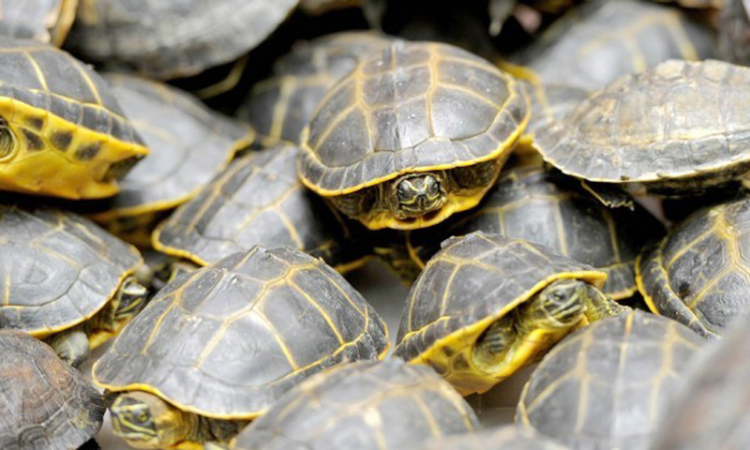
Steps In Natural Selection:
Let’s use turtles as an example. Lets pretend there was a population of turtles on an island.
Overproduction: Not every turtle will survive
Variation: each turtle has different characteristics (adaptations) that will help it to survive
Competition: The turtles will compete to survive
Selection: variations in the turtles will help some turtles to survive more than others
Survival and Reproduction: the turtles with the characteristics that are favored will survive and pass on their characteristics to their young.

Slide 7
Assignment: Natural Selection Cartoon
You are going to create a cartoon on Natural Selection.
Think of a unique animal trait or choose one below.
Elephants with trunks
Birds with wings to fly
Giraffes with long necks
Cheetah with spots
Frogs with long tongues
Zebras with stripes
Camels with humps
Deer with antlers
Your own choice ☺
You should draw 1 cartoon. The cartoon should have at least 4 panels with captions. Make sure to number your panels 1-4 so that you can demonstrate Darwin’s Theory of Natural Selection in action:
  Genetic Variation (identify the different traits within the species)
  The struggle for existence ( what is causing some to survive and some to die off?)
  Survival of the fittest (which ones survive and why?)
  Descent with Modification ( what characteristics will future generations have?)

Slide 8
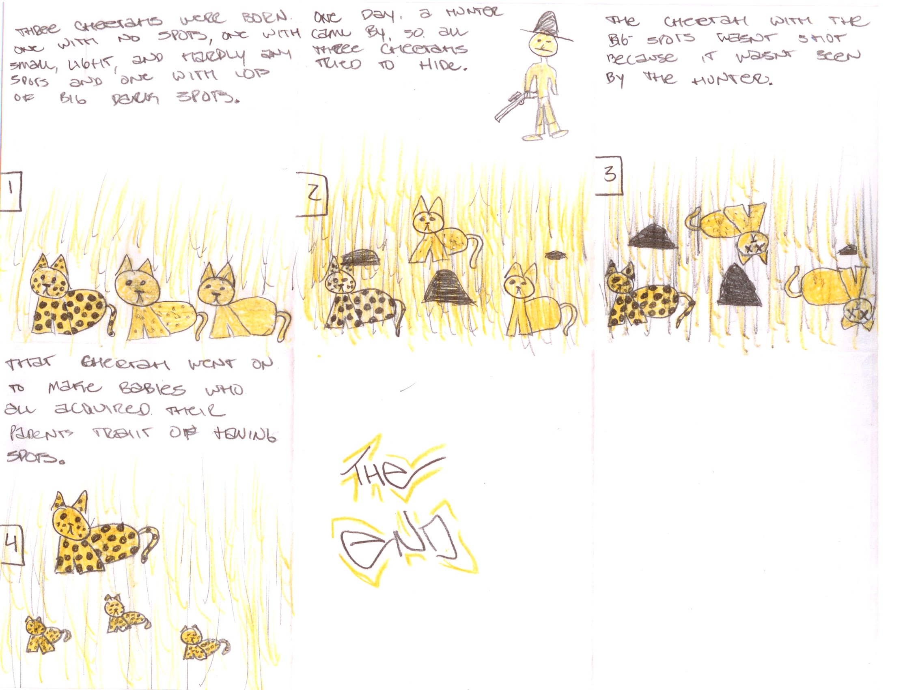
Here is an example:

