Slide 1
TEACHER PAGE
Lesson Objective:
Students will model and illustrate how the tilted Earth rotates on its axis, causing day and night, and revolves around the Sun causing changes in seasons.
PowerPoint Presentation Includes the following:
Animated graphics used to enhance content and facilitate students’ understanding of concepts.
Guided notes and Vocabulary over key concepts aligned with PowerPoint slides.
Answer Key
Diagrams illustrating planetary movement and seasons on Earth.
Student activity sheets with diagrams aligned to PowerPoint presentation.
Activity: Modeling Earth’s Changing Seasons
Using common classroom items, students will build models to demonstrate how the tilt of the
Earth and its revolution around the sun results in our seasons.
Student Activity Pages aligned with Modeling Earth’s Changing Seasons activity including printable step-by-step instructions for assembling the models, lesson procedure with pictures, and analysis questions.
Quick Quiz: Check for Understanding
Answer Keys
Key Concepts/Terms:
Earth’s Movement: rotation, axis, counter clockwise, orbit, revolution
Earth’s Seasons: tilt, hemispheres, Polaris, equator
TEACHER PAGE

Slide 2




Revolve
spring
Rotate
Earth’s movement
and seasons
summer
winter
orbit
fall
axis

Slide 3


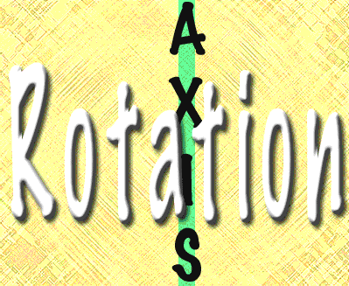
The Earth rotates on its axis once every 24 hours causing day and night.
Rotation is when a
planet or moon spins
on its axis one time.
The axis is an imaginary line going from the north pole to the south pole.

Slide 4
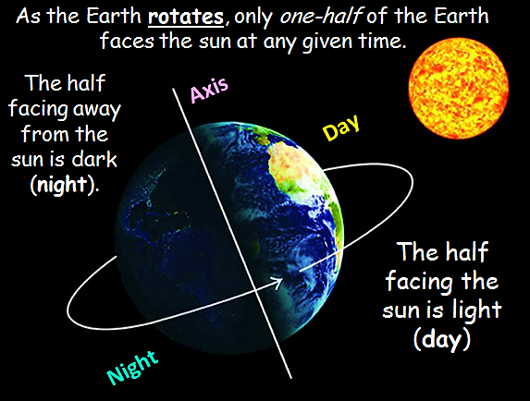

Slide 5
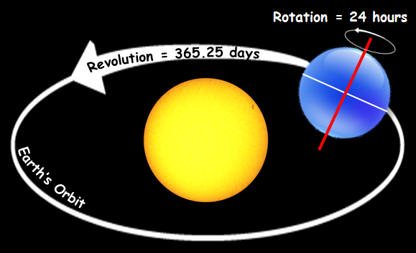

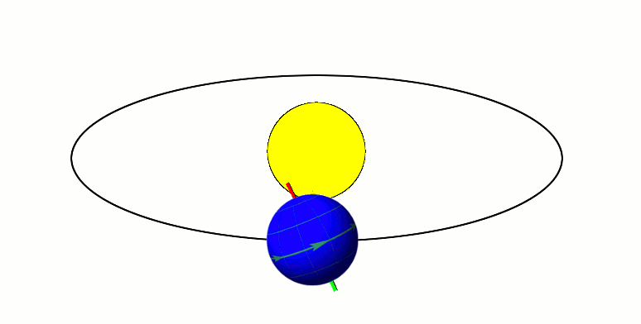
The Earth travels in a COUNTER CLOCKWISE direction around the sun.
Revolve = To go around.
The Earth revolves in a circular path, or orbit, around the sun.

Slide 6

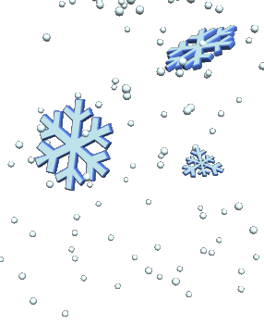



Slide 7
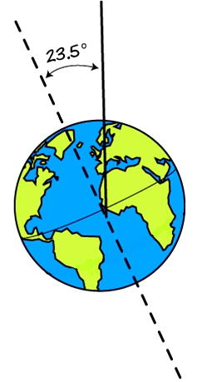
Reason #1
To The North Star
The Earth’s Tilt
We experience seasons because Earth's axis is tilted 23.5° towards the North Star, Polaris.
The tilt causes
the Earth’s hemispheres
to be at different angles
to the sun at different times of year.
Northern
Southern
Earth’s
axis

Slide 8
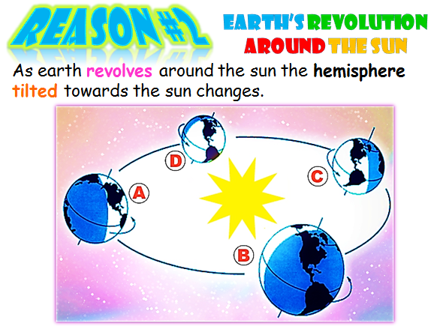





C. When the northern hemisphere is tilted away from the sun we experience winter.
B. and D. When the northern hemisphere is neither tilted towards nor away from the sun we experience fall or spring.
A. When the northern hemisphere is tilted towards the sun we experience summer.

Slide 9
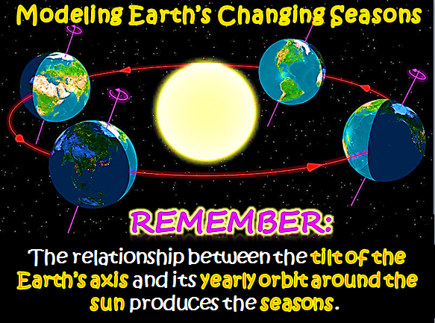

Slide 10



N
Materials Check List
Tennis ball
Rubber band
2 Pushpins
Protractor
Small cup
Flashlight
Paper plate
procedure
Equator
The equator divides
the Earth into two hemispheres or halves.
S
Step 1: The Equator and Poles
Use a rubber band to represent the equator on your model.
Insert the pushpins to represent the North and South poles.

Slide 11


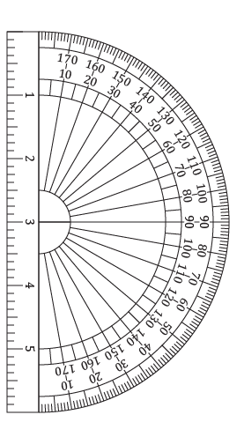

Step 2: The Earth’s Axis
The Earth is tilted at a 23.5 degree angle on its axis.
Set your model on the small paper cup.
Use a protractor to set up your model so that the axis of the Earth is tilted 23.5 degrees.
Before
after

Slide 12



Step 3: The Earth’s Orbit
The Earth revolves around the sun in its orbit.
Divide your paper plate into fourths.
Label the four seasons.
Add arrows to show the counter clockwise motion of the Earth around the sun.
Add the sun.
spring
summer
winter
fall

Slide 13

Step 4: The North Star
As the Earth orbits the Sun, the North Pole always points to
Polaris, The
North Star.
To The North Star
Set up your model so that the North Pole is pointing to the model of Polaris in the classroom.

Slide 14
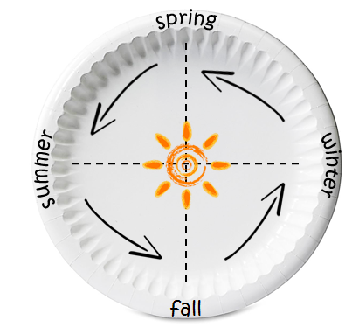

Step 5: Modeling Summer
Place a flashlight on the plate so that it is pointing toward the label for summer.
What
does the flashlight
represent?
2. Turn the plate and
flashlight so they are lined
up with the model of the Earth.

Slide 15
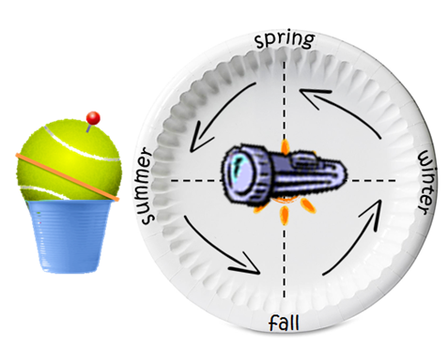
Modeling Summer – Analysis Questions
Are the direct rays from the flashlight hitting above or below the rubber band that is representing the equator?
Which hemisphere receives the greatest amount of sunlight in summer?
Which month is most
likely represented by
this location?
    December
    March
    September
    June

Slide 16
Step 6: Modeling Fall
(Autumn)
Without moving the plate, turn the flashlight around so that it is pointing toward the label for fall.
Keeping the North Pole pointing toward the model of Polaris, move the Earth model to the fall side of the plate.

Slide 17
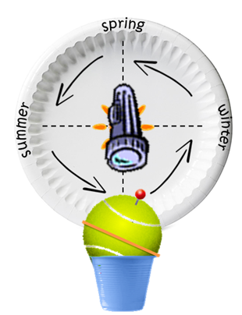
Modeling Fall (Autumn) – Analysis Questions
Are the direct rays from the flashlight hitting above or below the rubber band that is representing the equator?
Which hemisphere receives the greatest amount of sunlight during Fall?
Which month is most
likely represented by
this location?
    December
    March
    September
    June

Slide 18
Step 7: Modeling Winter
Without moving the plate, turn the flashlight around so that it is pointing toward the label for winter.
2. Keeping the North Pole pointing toward Polaris, move the Earth model to the
winter side of the plate.

Slide 19
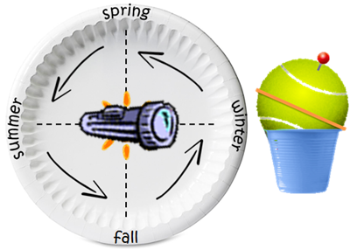
Modeling Winter – Analysis Questions
Are the direct rays from the flashlight hitting above or below the rubber band that is representing the equator?
Which hemisphere receives the greatest amount of sunlight during winter?
Which month is most likely represented by this location?
    December
    March
    September
    June

Slide 20
Step 8: Making Predictions
If the flashlight and the Earth model are moved into the spring position, will the direct rays from the flashlight hit above or below the rubber band that is representing the equator?
Which hemisphere receives the greatest amount of sunlight during spring? Explain.
Which month is most likely represented by this location?
    December
    March
    September
    June

Slide 21


Quick Quiz
What is the motion of Earth traveling around the sun called?
Which direction does it travel?
How long does it take for the earth to spin once on its axis?
What do we call the path that the earth takes to travel around the sun?
The Earth REVOLVES around the sun.
The Earth travels in a COUNTER CLOCKWISE direction.
It takes the Earth 24 hours to complete one rotation on its axis.
The Earth travels around the sun in a path called an ORBIT.

Slide 22
A
5. Which Diagram represents summer in Texas?
6. Which Diagram represents winter in Texas?
B
N
Diagram A
S
B
7. Which diagram shows winter in the southern hemisphere?
8. Does the northern hemisphere get warmer when it is
leaning towards or away from the sun?
towards the sun
N
Diagram B
S

Slide 23
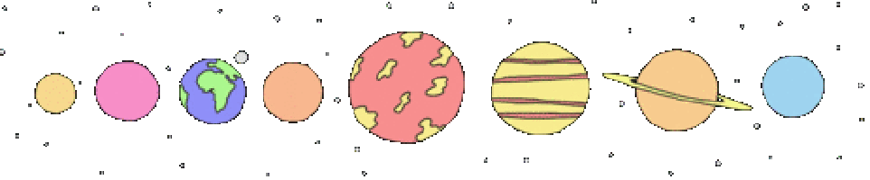
STUDENT
Activity
pages

Slide 24
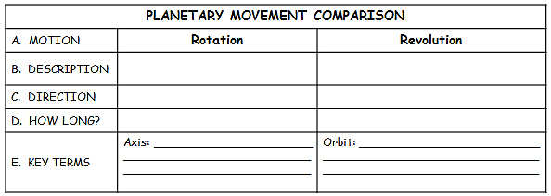
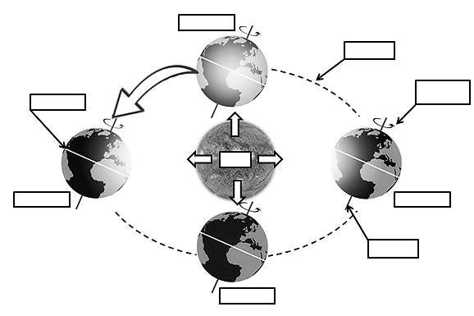
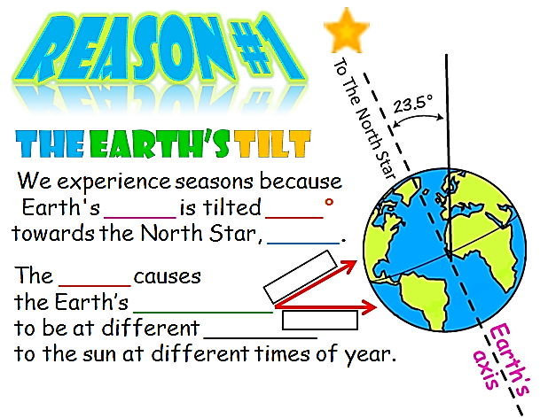

Name______________________________________Date________________Period___
A. When the northern hemisphere is tilted towards the sun we experience _____________.
C. When the northern hemisphere is tilted away from the sun we experience _____________.
B. and D. When the northern hemisphere is neither tilted towards nor away from the sun we experience ______or __________.
Earth’s Changing Seasons
The relationship between the _______ of the Earth’s ______ and its yearly _______ around the ______ produces the seasons.
D
A
C
B

Slide 25
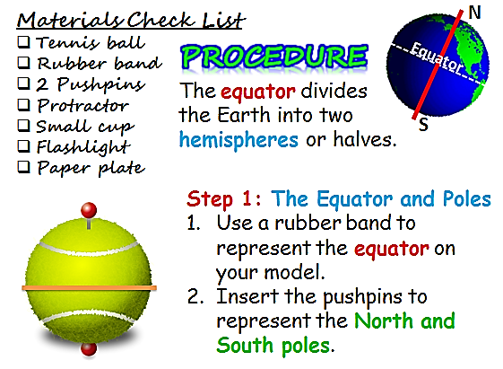
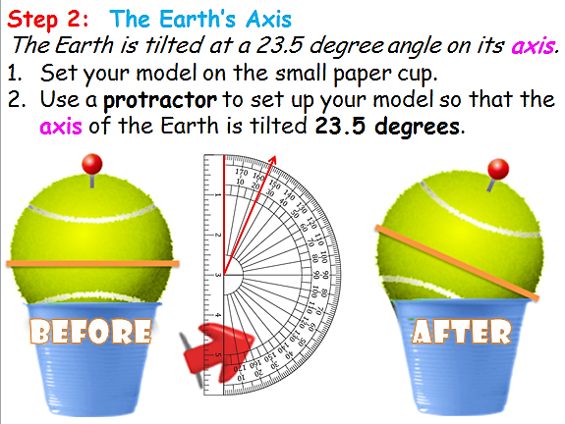
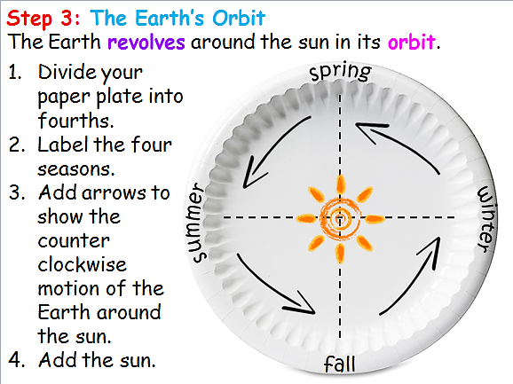
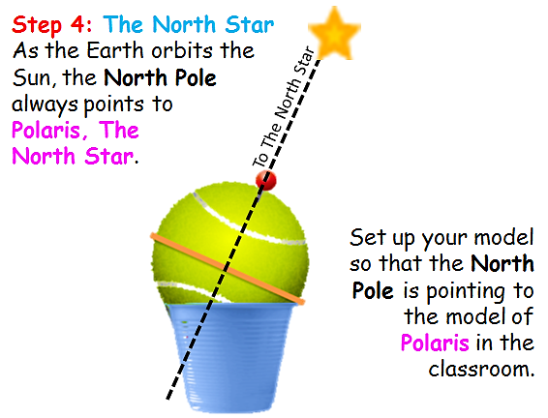
The Reasons for Earth’s Seasons – Student Activity Sheet page 1
Name__________________________Date__________Period___

Slide 26
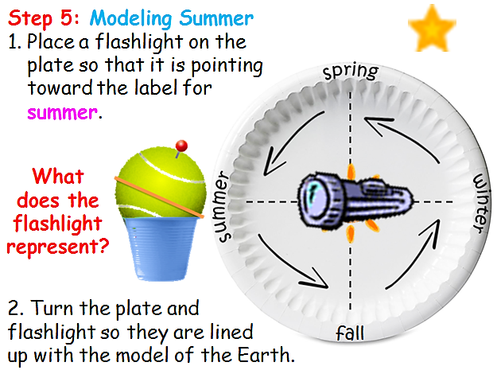
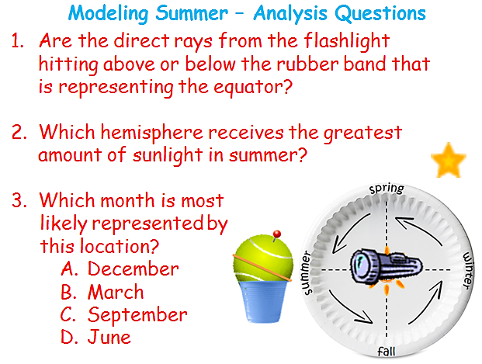
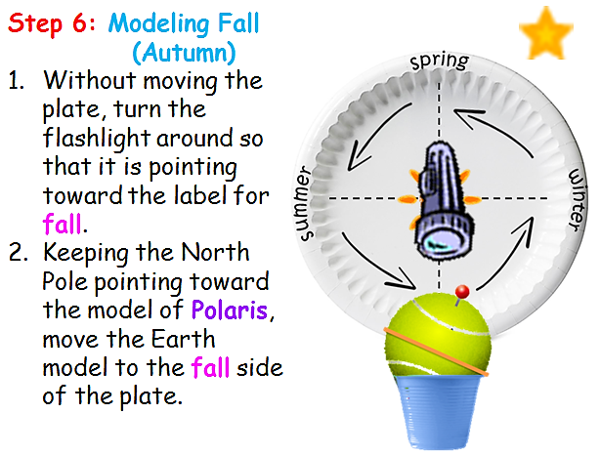
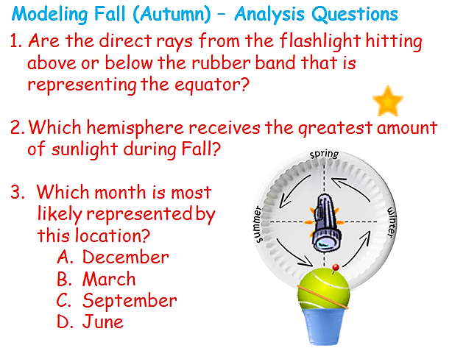
The Reasons for Earth’s Seasons – Student Activity Sheet page 2
Name__________________________Date__________Period___

Slide 27
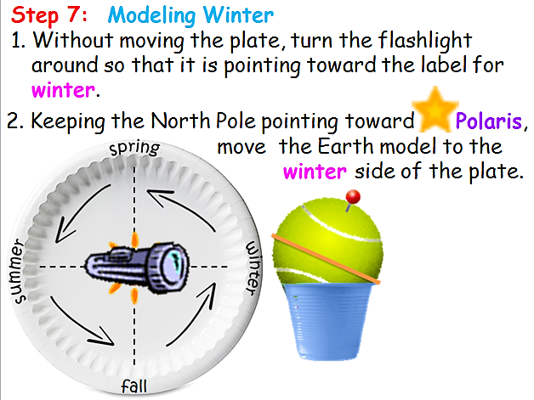
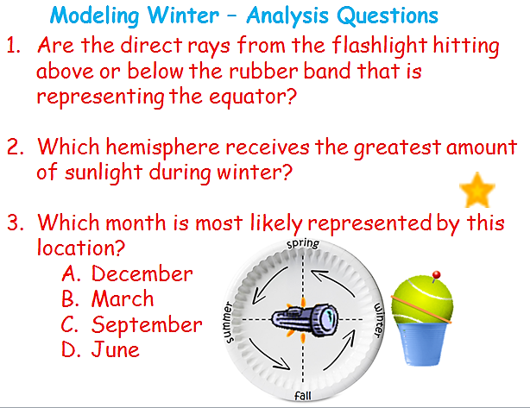
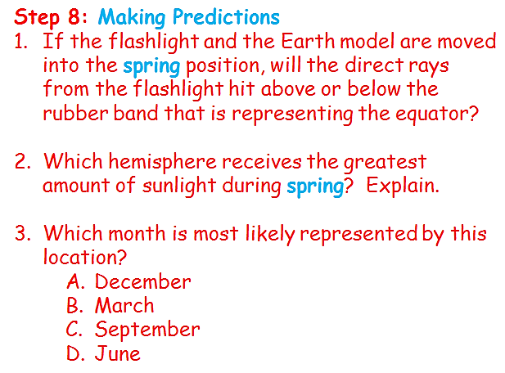
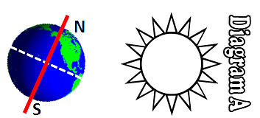
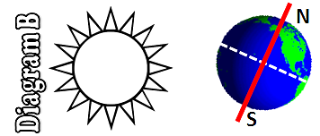
The Reasons for Earth’s Seasons – Student Activity Sheet page 3
Name__________________________Date__________Period___
Quick Quiz
What is the motion of Earth traveling around the sun called?
Which direction does it travel?
How long does it take for the earth to spin once on its axis?
What do we call the path that the earth takes to travel around the sun?
5. Which Diagram represents summer in Texas?
6. Which Diagram represents winter in Texas?
7. Which diagram shows winter in the southern hemisphere?
8. Does the northern hemisphere get warmer when it is leaning towards or away from the sun?

Slide 28
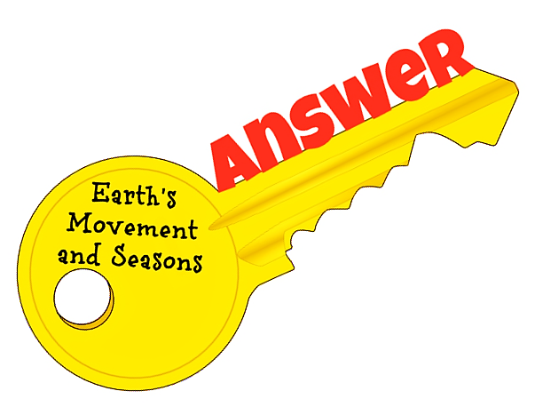

Slide 29
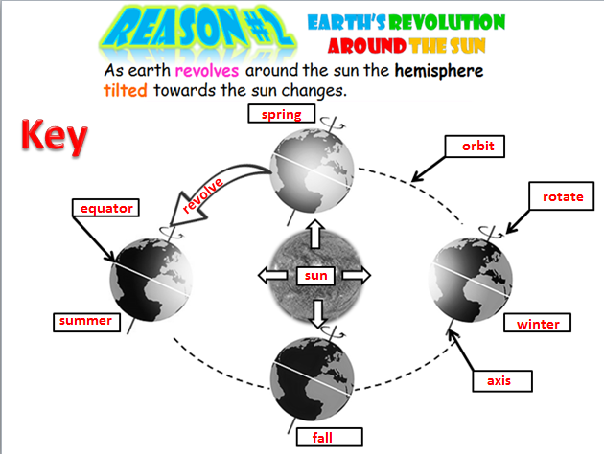

Slide 30
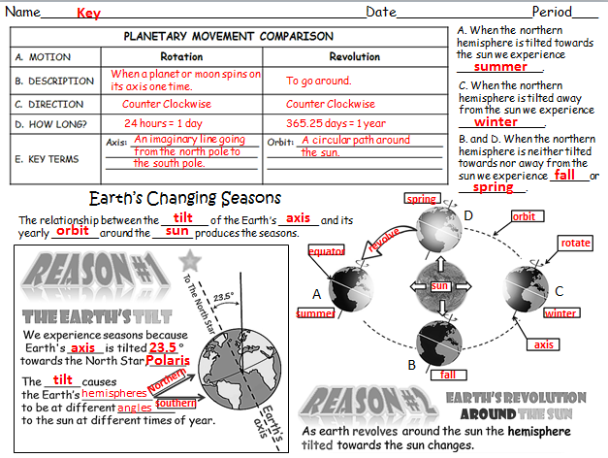

Slide 31
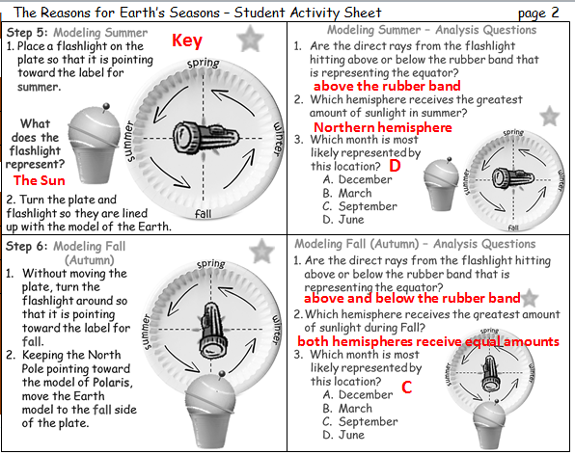

Slide 32
