Slide 1
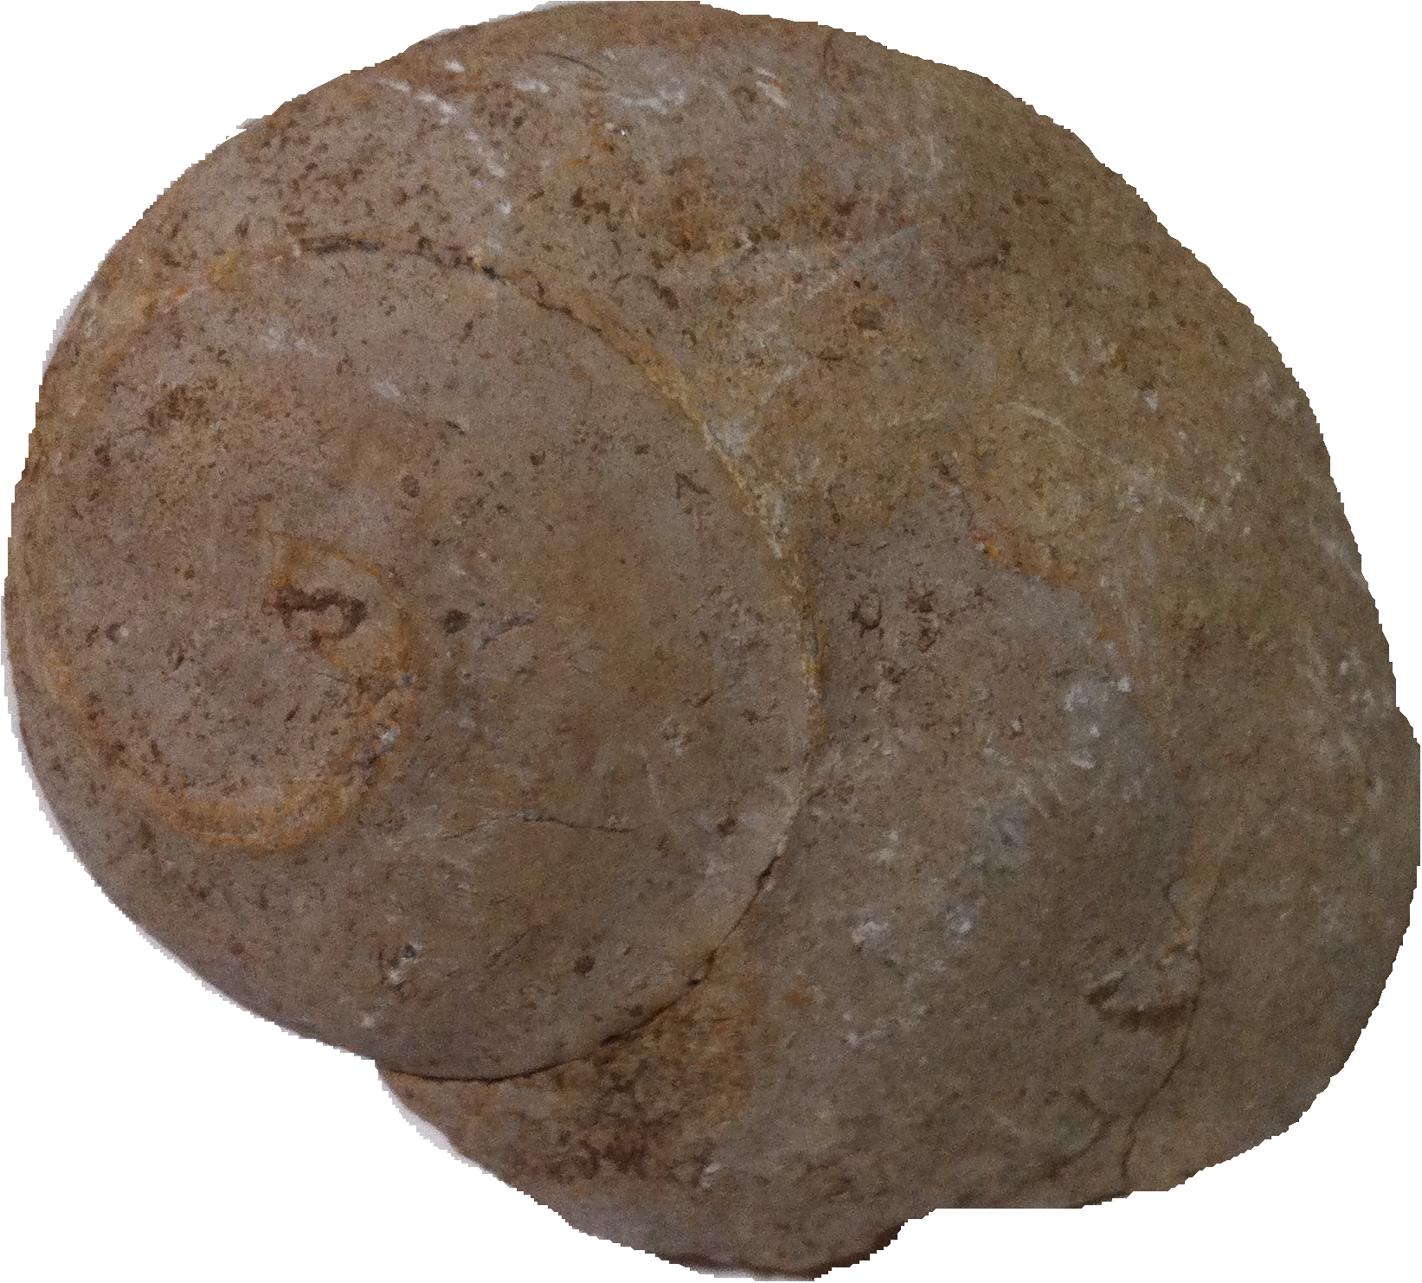
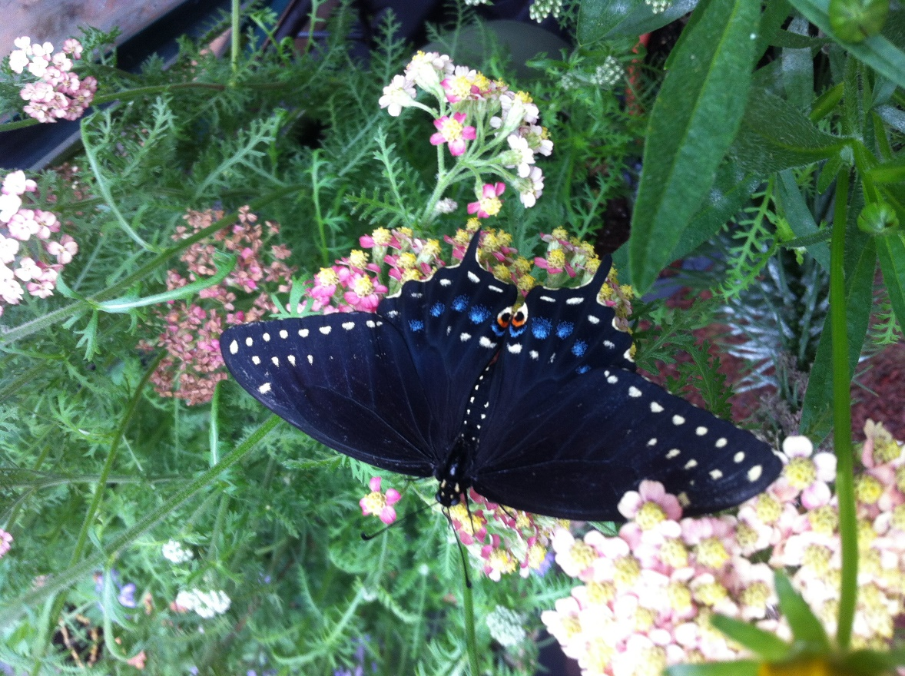
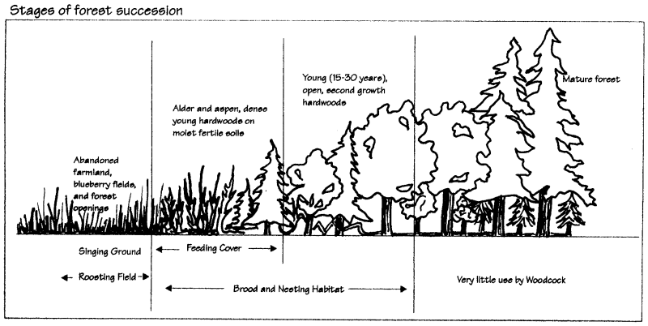
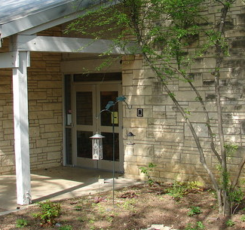

Blackland Prairie
Ecosystem
Annotated Drawing-
Ecological Succession
Who We Are
About Us
The Holifield Science Learning Center staff is a group of people dedicated to the education of our Plano ISD students. We are proud to provide both outdoor education and animal outreach that emphasizes ecology TEKS and focuses on real-world applications.
This drawing is an example of ecological succession in a forest and how it affects certain species of birds.
The biodiversity of plants and animals are interrelated. The more variety of plants, the more variety of animals that can be supported in that ecosystem.
The more biodiverse an ecosystem is, the more healthy the ecosystem is.
This principle is important to remember- even in our own backyards.
Holifield Science Learning Center
Source Material
Contact Us
Texas Parks and Wildlife <www.tpwd.gov>
World Wildlife Fund <www.worldwildlife.org>
Plano ISD <www.pisd.gov>
Phone: 469-752-1190
Email: [Email address]
Web: http://k12.pisd.edu/holifield-science-learning-center
HSLC- Plano ISD
Holifield Science Learning Center
Plano ISD
3401 E. Spring Creek Pkwy
Plano, TX 75074
(972) 752-1190

Slide 2
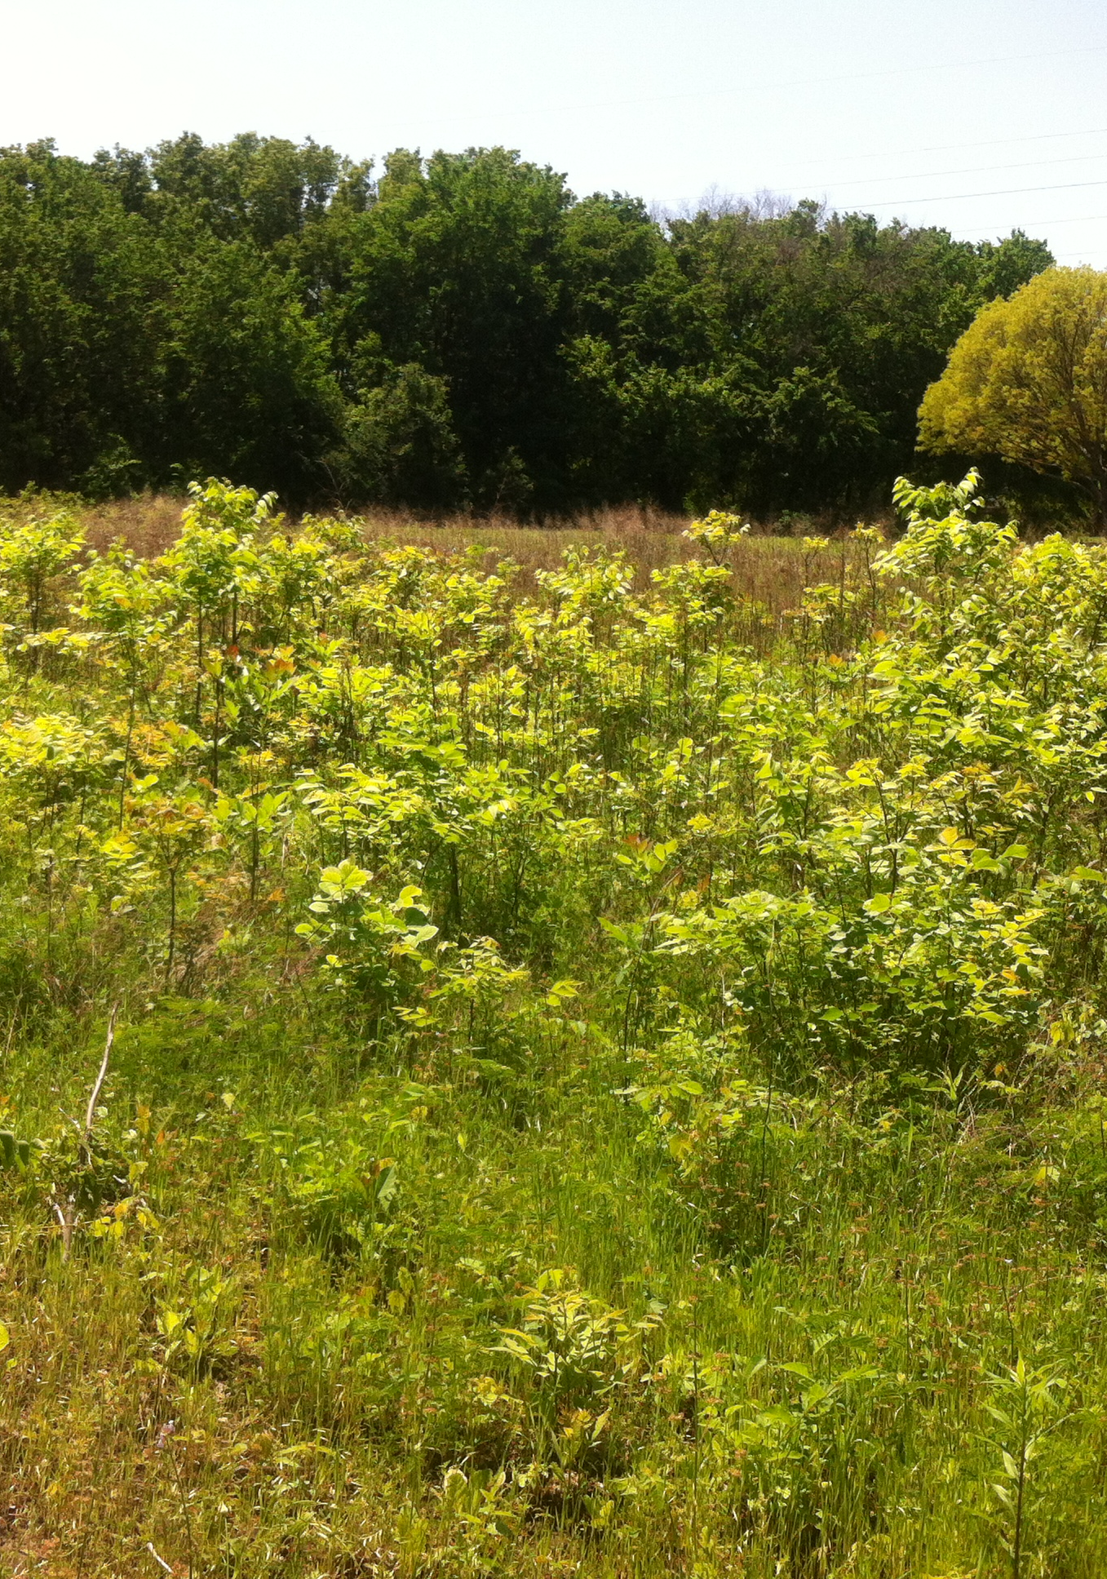
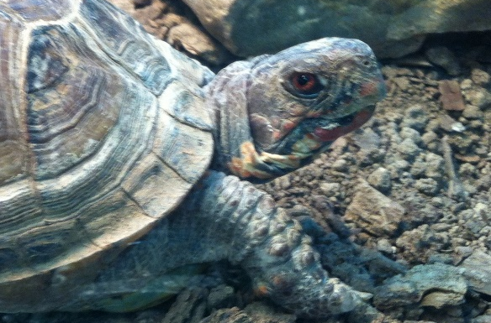
What happens next?
The trees are now regrowing among the grasses and wildflowers. As the grasses spread many varieties can be seen such as gama grass and little bluestem. Some of the native trees include live oak, rough dogwoods and redbuds.
“Ecological Succession is a set of changes that happen to an environment over time.”
Blackland Prairie Native – Ornate Box Turtle
The natural range of this turtle stretches from Texas to Missouri. Much of its native range, throughout several states, is declining.
What part do turtles play in the Blackland Prairie?
Turtles serve as food for many animals including bobcats, coyotes and decomposers. In turn, the turtles eat many insects and vegetation. The Blackland Prairie habitat is being affected by suburban encroachment, injuries from cars and pollution.
What can be done about it?
Planting native trees, grasses and shrubs will help the wildlife found naturally in the Blackland Prairie. Also, helping to keep our landscapes and parks free of trash and runoff will allow plants and animals to flourish. The Blackland Prairie was once a large swath of land stretching hundreds of acres. The more land we can dedicate to the this ecosystem, the more species will survive.
Why is the ecoregion called the Blackland Prairie?
Primary
Secondary
Climax
The region is named after the dark, clay soil in the area. Upper cretaceous marine chalks, shales and marls gave rise to this soil. This rock is known for many marine fossils and is called the Austin Chalk Formation. It is the rock that circles the Holifield Science Learning Center building. The rock is white when dry and consists of calcite and aragonite. This land formation is visible in many of the creek beds of the area.
Ecological Succession
What does ecological succession mean?
Ecological succession is a set of changes that happen to an environment over time. This is a picture of the Blackland Prairie on the edge of a small forest. The primary plant species are grasses and wildflowers. After these primary species move in, secondary species start to grow. This field was burned by a fire and now, after many years, the trees are growing back. In 10-15 years, if left undisturbed, this section of land will become forest again.
What was the ecoregion like before settlement occurred?
This region is known for large tracts of grasslands and wildflowers. Prior to 1825, bison roamed the land and trees were discouraged because of frequent wildfires.

