Slide 1

Ocean currents

Slide 2
The density of water goes from less dense on the surface to more dense at the bottom of the ocean.
FACT

Slide 3
Surface ocean currents are driven by temperature and salinity.
FICTION

Slide 4
The global conveyor belt is a system of the ocean’s currents.
FACT

Slide 5
The Coriolis effect causes gyres to form.
FACT

Slide 6
Deep ocean currents move in circular patterns called gyres.
FICTION

Slide 7
Upwelling usually occurs at the poles.
FICTION

Slide 8
Deep ocean currents move faster than surface currents.
FICTION

Slide 9
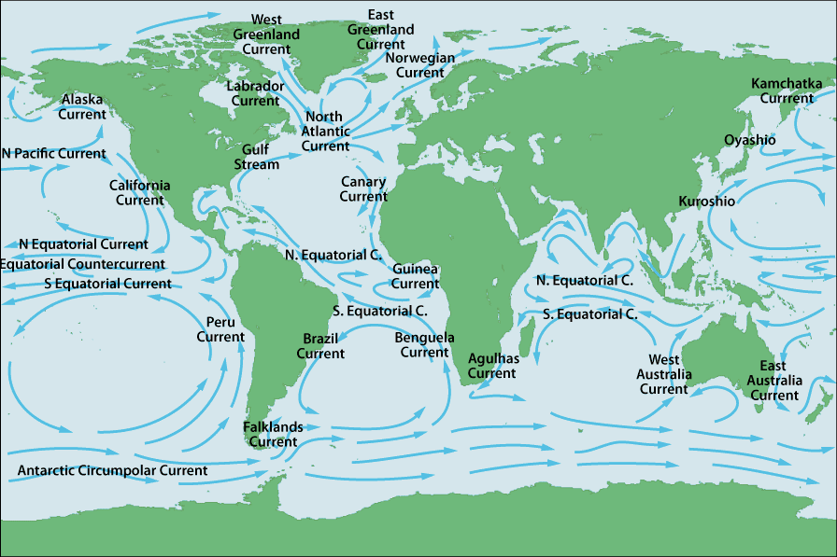
How to interpret an ocean current map.

Slide 10
Ocean water is on the move, affecting your climate, your local ecosystem, and the seafood that you eat. Ocean currents, abiotic features of the environment, are continuous and directed movements of ocean water. These currents are on the ocean’s surface and in its depths, flowing both locally and globally.

Slide 11
On an ocean current map there are two types of currents cold water currents and warm water currents.
Cold water currents will cool down the temperature and the overall climate of the continents they pass by while warm water currents usually increase the temperature and create warmer and/or humid climates of the climates they pass.
How do you identify warm water and cold water currents on an ocean current map?

Slide 12
Warm water currents are currents that are moving water from the equator towards the poles.
Cold water currents are currents that are moving water from the poles towards the equator.
At each table you should find blue and red map pencils. You will share these with your table mates. You will trace all the warm water currents in red and the cold water currents in blue on the map given to you.

Slide 13
Warm water currents are carrying warm water from the equator towards the poles.
Cold water currents are carrying cold water from the poles towards the equator.
EQUATOR

